Slide 1
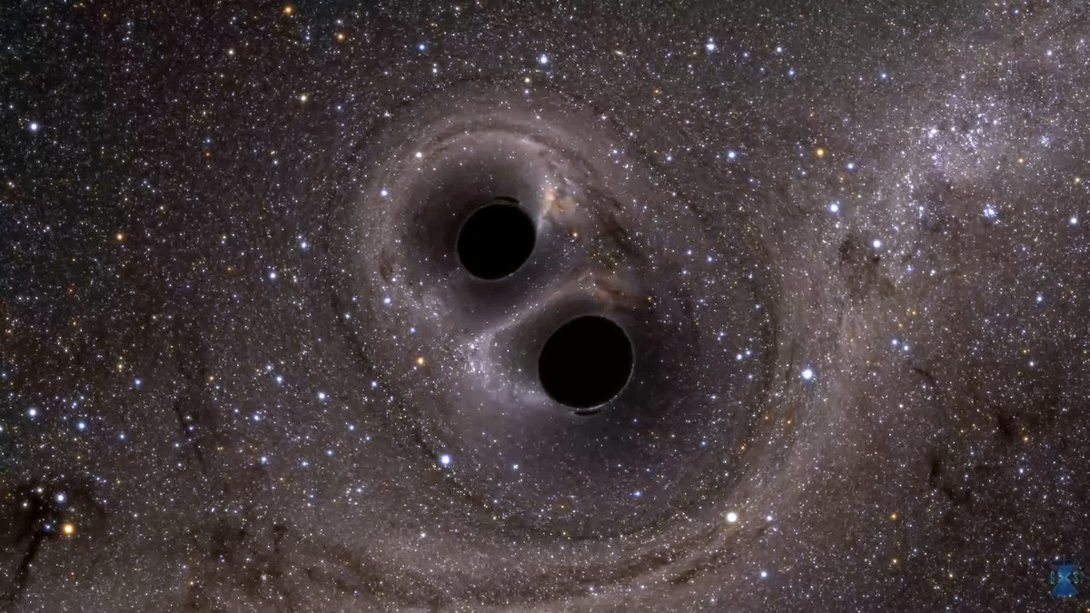
Black Hole Mergers

Slide 2
Intro on topic

Slide 3
Previous research(?)

Slide 4
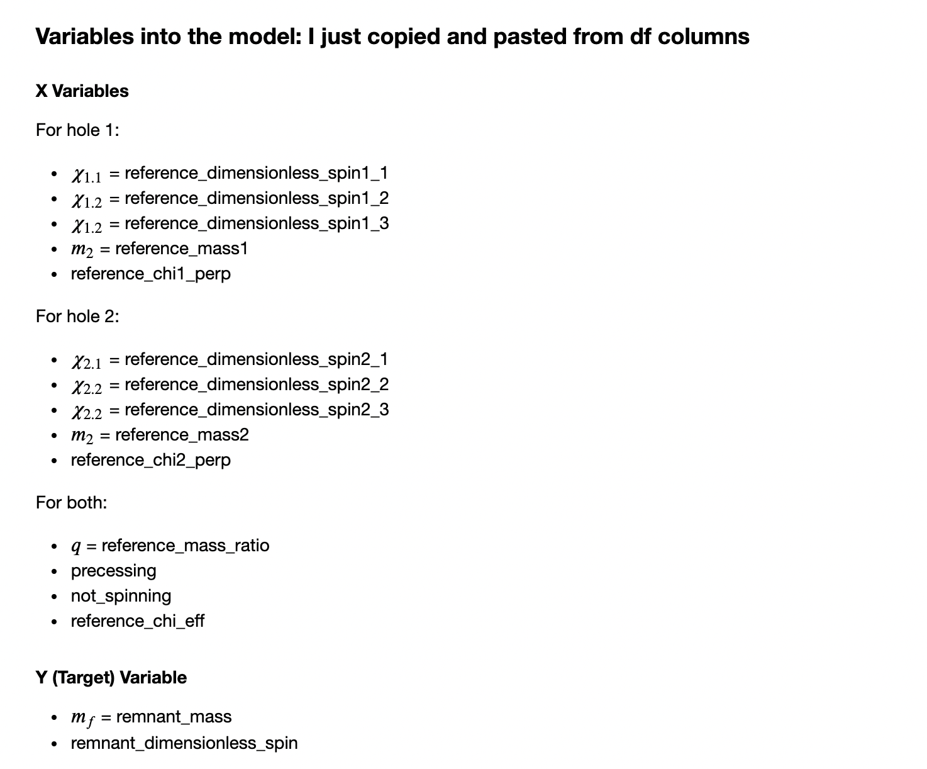
Initial Variables

Slide 5
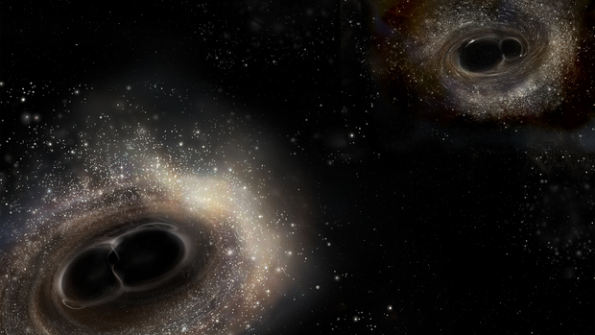
Predicting Mass

Slide 6
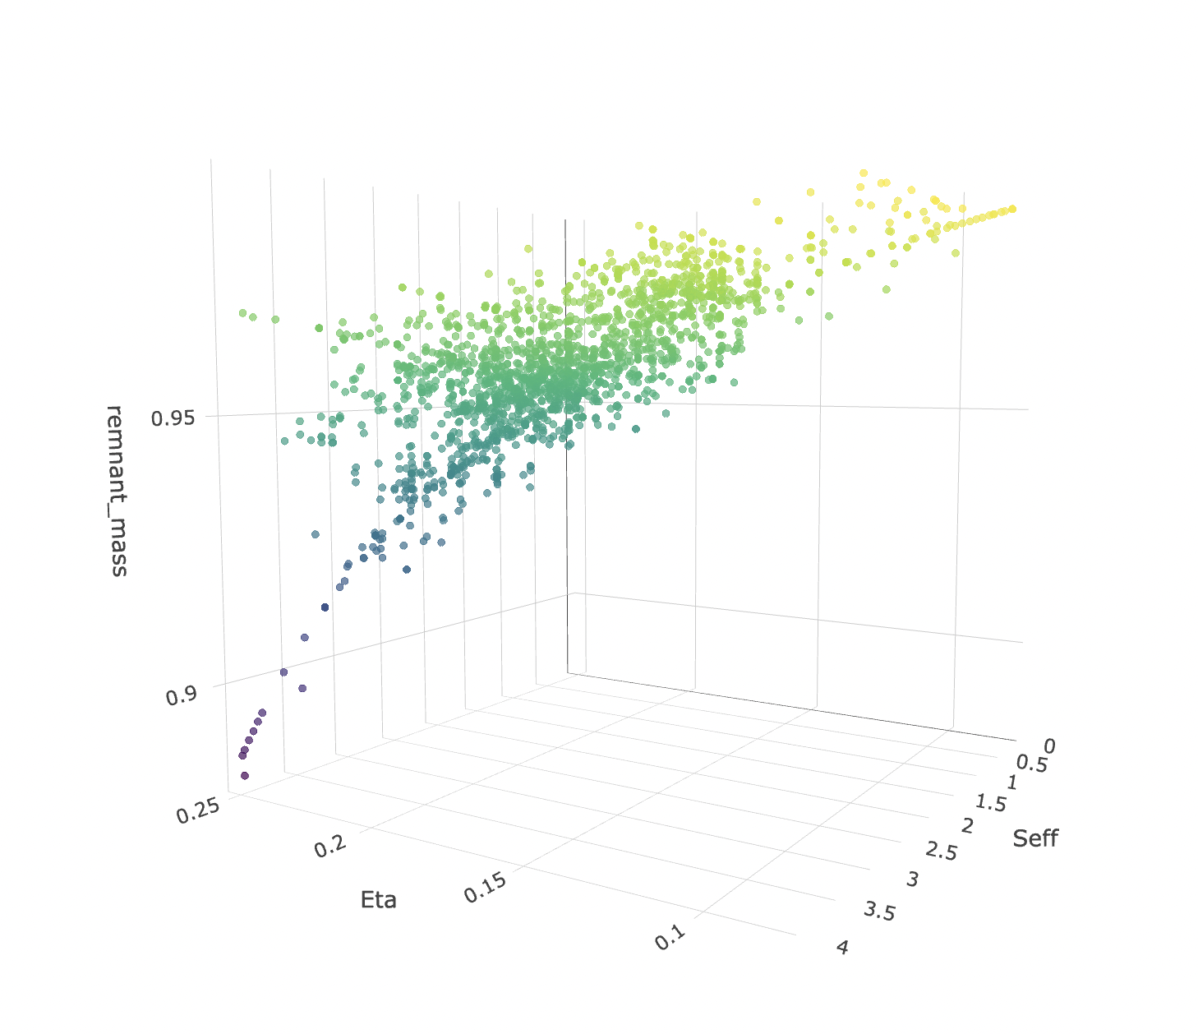
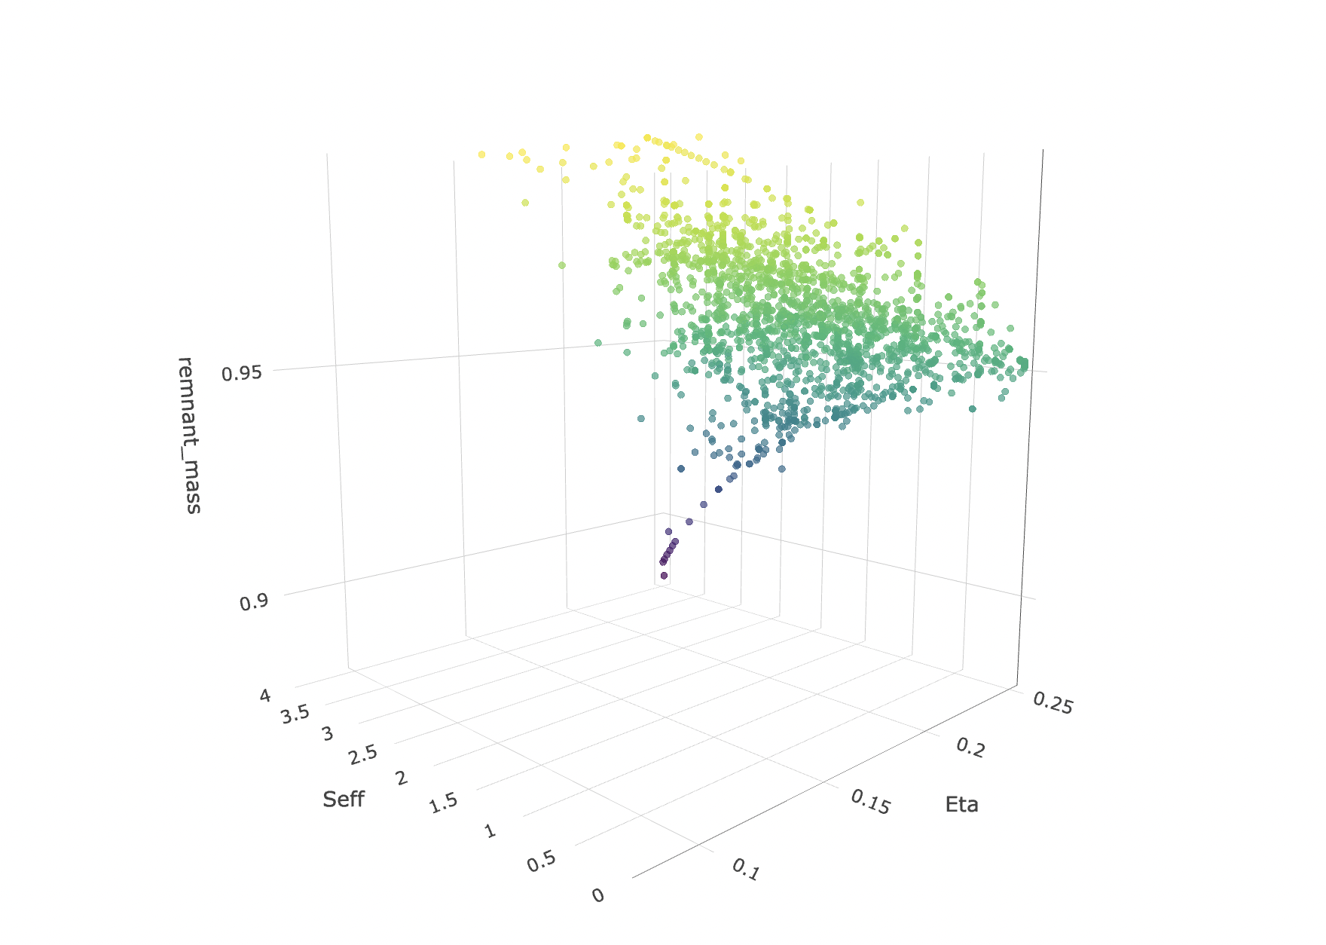
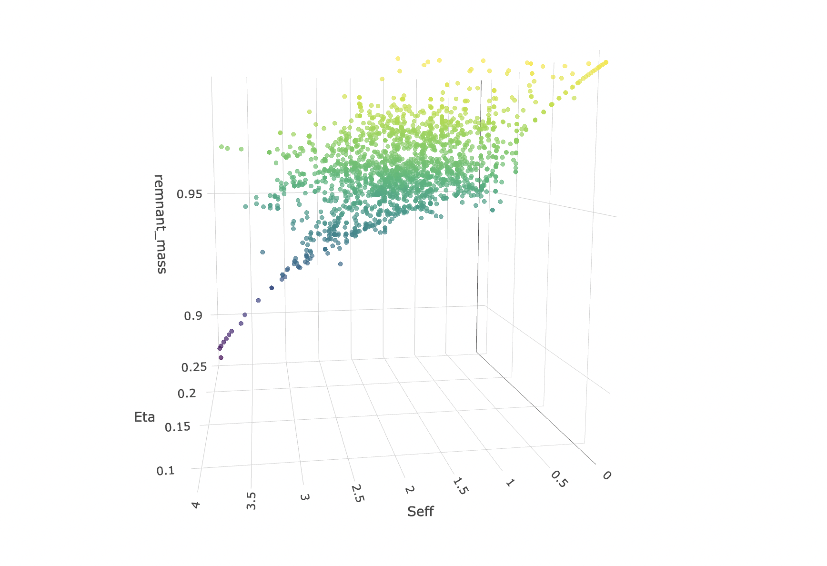
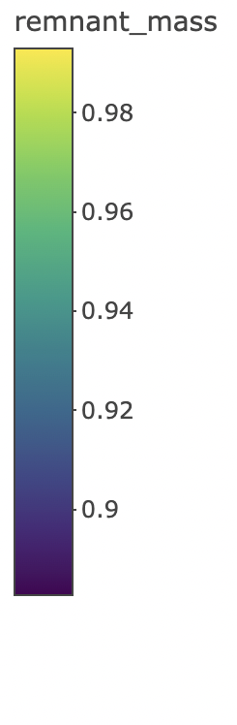
1 or 2 slides w visualizations? Much better a video

Slide 7
Functional equations for both targets

Slide 8
Data cleaning
Outliers
Masses not adding to one
Etc
Etc

Slide 9
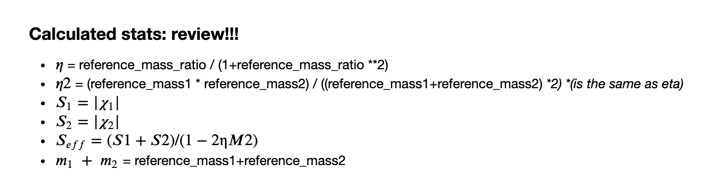
Feature engineering

Slide 10
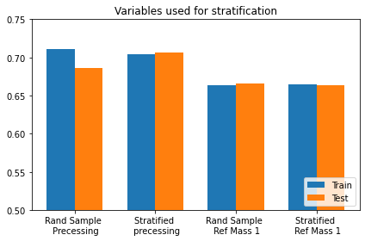
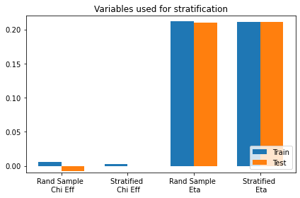
Stratified Sampling

Slide 11
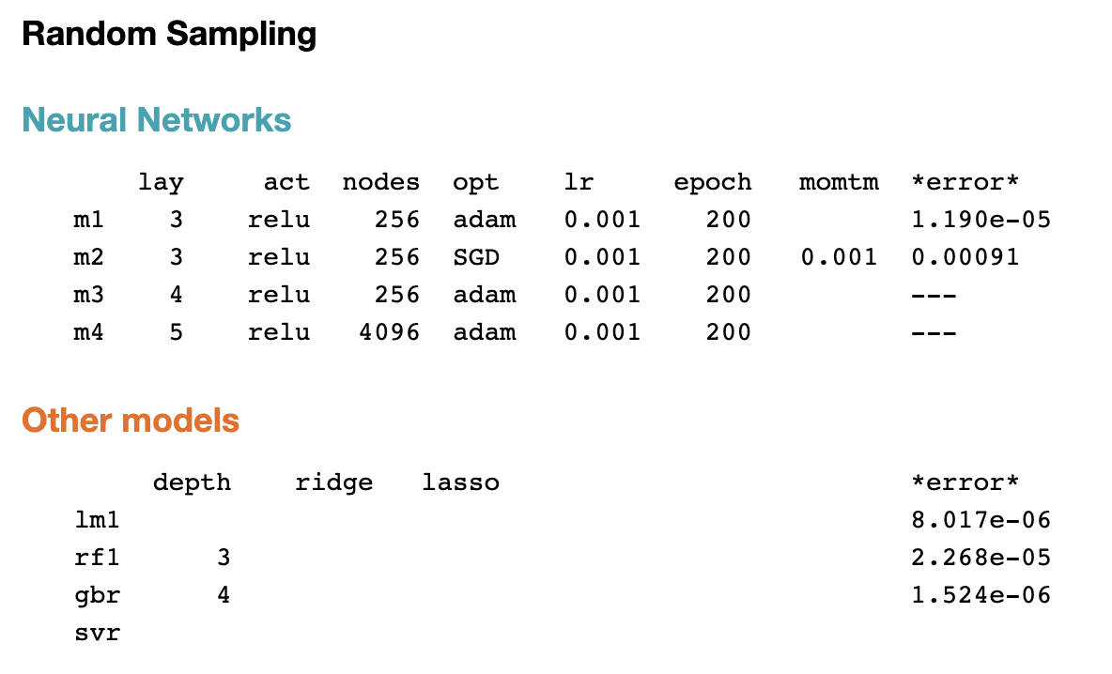
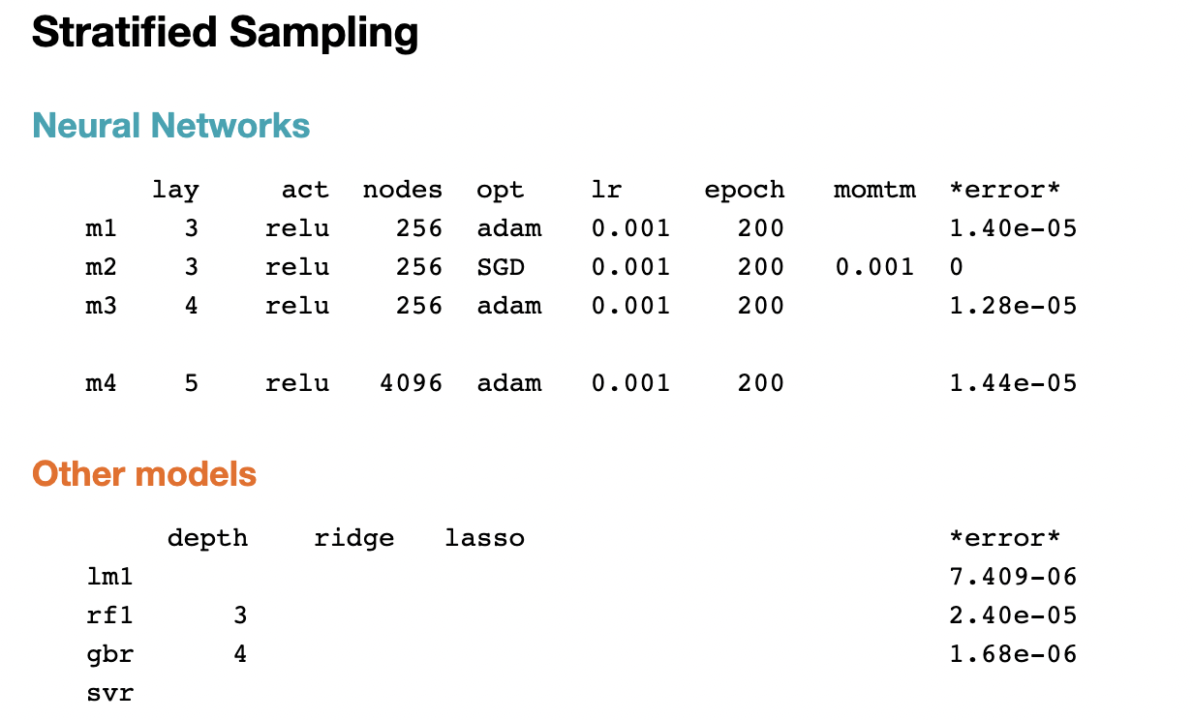
Models

Slide 12
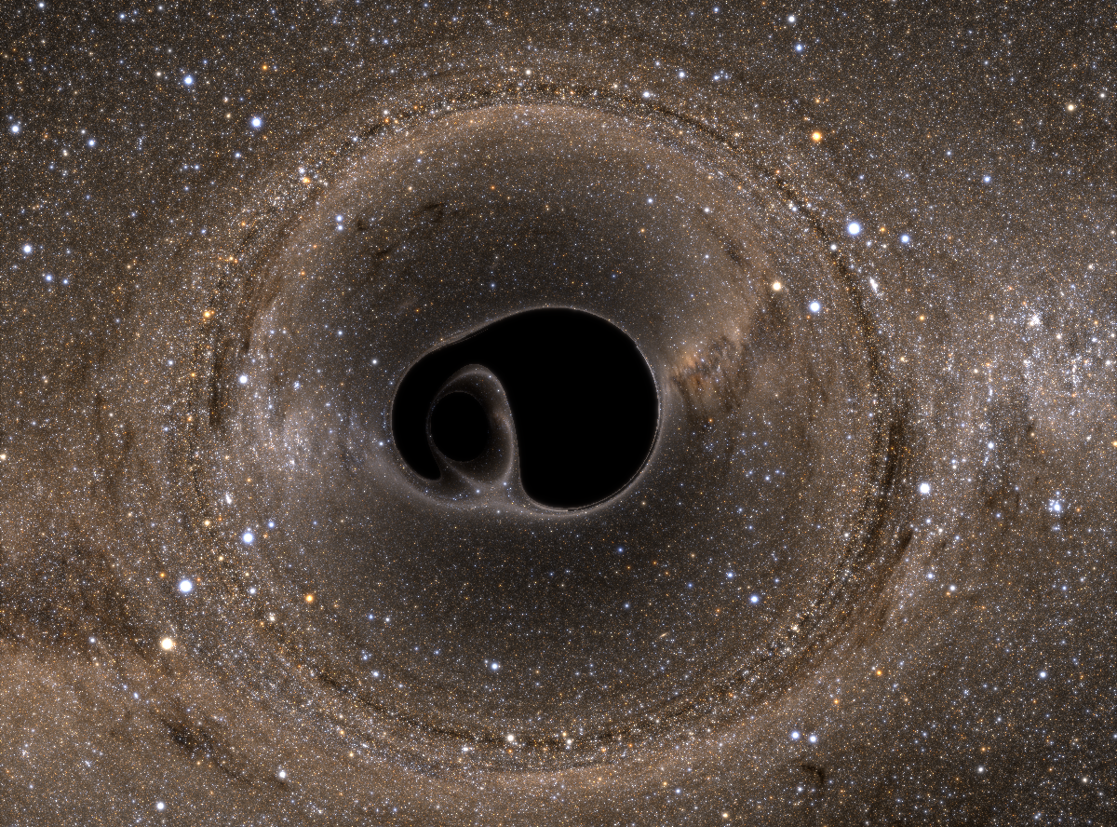
Predicting Spin

Slide 13
Repeat all prev steps

